Slide 1

PROJE CT 111
GROUP 2

Slide 2
OUR TEAM
Nisarg Patel - 201801013
Margi Hingrajia - 201801014
Shantanu Tyagi - 201801015
Visaj Shah - 201801016
Mitesh Koradia - 201801017
Mahaveer Bohra - 201801018
Rohan Jasoria - 201801019
Kirtan Delwadia - 201801020
Prayush Dave - 201801021
Harshil Joshi - 201801022
Arihant Pratap Singh - 201801023

Slide 3
Honour Code
We declare that:
The work that we are presenting is our own work.
We have not copied the work (the code, the results, etc.) that someone else has done.
Concepts, understanding and insights we will be describing are our own.
We make this pledge truthfully. We know that violation of this solemn pledge can carry grave consequences.

Slide 4
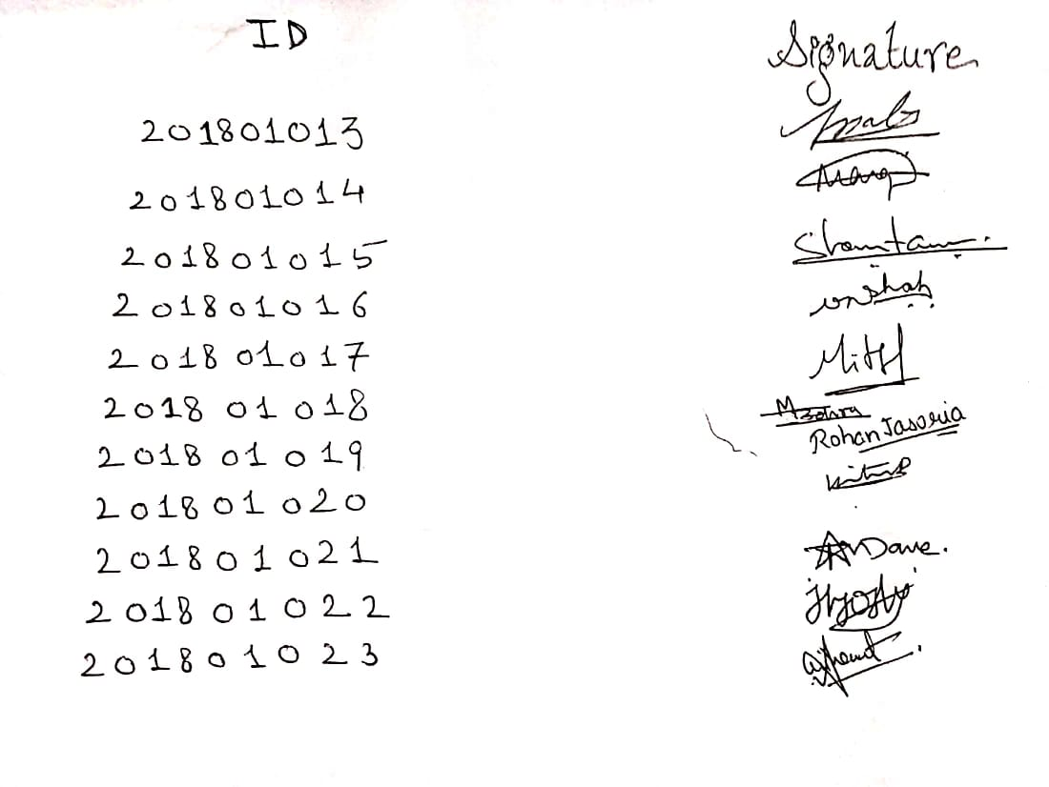
Honour Code

Slide 5
Project Deliverables
We are able to deliver:
(n,k) Product Code encoder and decoder using Tanner Graph
BSC and BEC error-introducing channel
LDPC Code decoder using Tanner Graph
Probability analysis and comparison of theoretical and actual probability

Slide 6
Contents:
Product code encoder
LDPC code
BEC
BSC
Parity check matrix
Tanner graph
Decoder
Graphs

Slide 7
(n,k) Product Code Encoder
Number of information bits = k
Number of codeword bits = n
Matrix | Dimensions
u | k x 1
G | n x k
c | n x 1
H | (n-k+1) x n

Slide 8
(n,k) Product Code Encoder
The codeword is of the form →
m1 | m2 | p1 | m3 | m4 | p2 | p3 | p4 | p5
m1 | m2
m3 | m4
m1 | m2 | p1
m3 | m4 | p2
p3 | p4 | p5

Slide 9
(n,k) Product Code Encoder
p1 = m1 m2
p2 = m3 m4
p3 = m1 m3
p4 = m2 m4
p5 = p1 p2

Slide 10

(9,4) Product Code G

Slide 11
LDPC Code
LDPC codes are also known as Gallager codes, in honor of Robert G. Gallager, who developed the LDPC concept at M.I.T. in 1960 during his Ph.D.
LDPC code is a linear error correcting code which is sparse in terms of the percentage of 1’s in the parity check matrix.
For a regular LDPC code every code digit is contained in the same number of equations and each equation contains the same number of code symbols. So the row and column weights are same respectively.
Irregular LDPC code contradicts this condition.

Slide 12
LDPC Code
Importance of LDPC -
LDPC is used in satellite transmission for digital television.
LDPC is also applied in ethernet and WiFi.
LDPC is a key feature of 5G communication.
An logy b tw en LDPC and daily co mu cation.

Slide 13
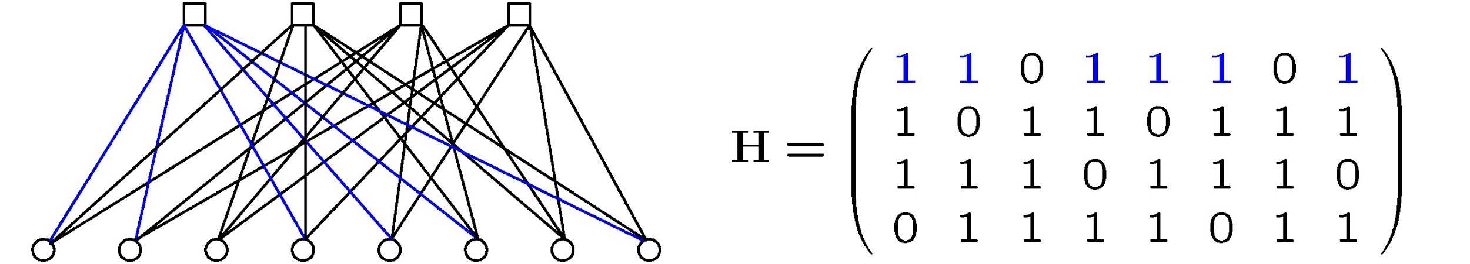
Check nodes
LDPC code is different from primitive parity check codes in terms of smaller parity check sets(density), additional security check nodes for parity bits and randomised connections between the two categories of nodes.
LDPC codes have no limitations of minimum distance, so LDPC codes may be more efficient on relatively large code rates
Variable nodes

Slide 14
BSC AND BEC
Algorithm for BSC (Binary Symmetric Channel) →
If i < n, repeat steps 2 to 4.
Randomly generate a probability q.
If q < input probability p
Flip the i^{th} bit. (flip → 1 to 0 and 0 to 1)
Increase i by 1.
Initial value of i = 0

Slide 15
BSC AND BEC
Algorithm for BEC (Binary Erasure Channel) →
If i < n, repeat steps 2 to 4.
Randomly generate a probability q.
If q < input probability p
Erase the i^{th} bit.
Increase i by 1.
Initial value of i = 0

Slide 16
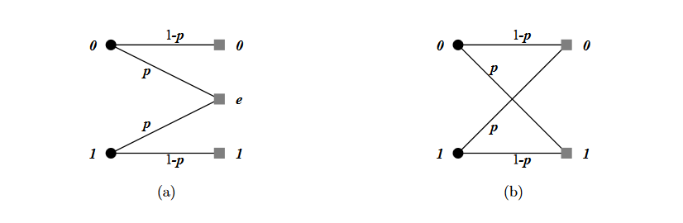
BEC BSC

Slide 17
Parity Check Matrix
Parity check matrix is used to check whether the decoded signal is a valid codeword or not.
Formula used to check this is : S = H * C , where H is Parity check matrix , C is decoded signal and S is Syndrome vector.
‘C’ here is generated using decoders like Tanner graph.

Slide 18
Parity Check Matrix
Here this matrix is of dimension ((n-k+1) X (n)) .
Its columns signifies the total number of bits which are represented in a manner => [ m1 m2 p1 m3 m4 p2 p3 p4 p5] ,here ‘m’ represents message bits and ‘p’ represents parity bits.
Each row signifies a Syndrome which depends on the bits with value 1.
Generally there are ‘n-k’ Syndromes , but using them we may not get the exact value of correct codeword .

Slide 19
Parity Check Matrix
The matrix generated after multiplication of Parity check matrix(H) and Codeword matrix (C) is Syndrome matrix(S).
If the resulting Syndrome matrix of dimensions ((n - k +1) X 1) is all zero then our decoded signal C is a valid codeword .
If ‘1’ is present at any location in syndrome vector then our generated C is wrong and has to go through another decoding iteration.

Slide 20
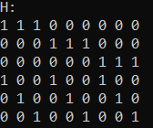
(9 , 4) Parity Check Matrix

Slide 21
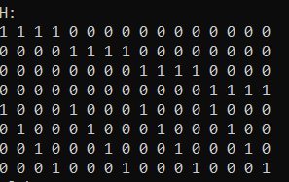
(16 , 9) Parity Check Matrix

Slide 22
Tanner Graph
From the H matrix we plot the Tanner Graph
S1
S2
S3
S4
S5
C1
C2
C3
C4
C5
C6
C7
C8
C9

Slide 23
Message-Passing Algorithm
CNi
CNi
CNi
CNj
CNk
Alpha(n-1)
VNi->CNi
Alpha(n-1)
VNk->CNi
Beta(CNk->VNi)
(n-1) iteration index
Beta(CNi->VNi)
(n-1) iteration index
VNi
VNj
VNk
VNi
The value of R is the output of channel ith bit of the codeword
Message from VNi toward CNj =Alpha(VNi->CNj)
Message from CNi toward VNj =Beta(CNi->VNj) { (n) iteration index}
R

Slide 24
Message-Passing Algorithm
While calculating message of any alpha(ex. VNi->CNj) in Nth iteration we take the majority of beta values(ex. CNk->VNi) (N-1)th iteration and value of ith index of codeword.
While calculating message of any beta(ex. CNi->VNj) in Nth iteration we take XOR of all alpha values(VNk->CNi) (N-1)th iteration

Slide 25
Decoder for (n,k) Product Code
At the receiver when the transmitted data is received , some bits are erased /corrupted and we use a decoder to recover those bits.
Set the initial value of alpha for each VN , which is same as the value of that VN in received codeword.
Decoding process
Find Beta- While calculating message of any beta(ex. CNi->VNj) in Nth iteration we take XOR of all alpha values(VNk->CNi) (N-1)th iteration

Slide 26
Continued...
2. Update the value of VNs
To update the value of each VN we are doing majority of Beta(CNi->VNi) and the value of received codeword which has index same of the VN.
3. Find Alpha
Alpha-While calculating message of any alpha(ex. VNi->CNj) in Nth iteration we take the majority of beta values(ex. CNk->VNi) (N-1)th iteration and value of ith index of codeword.

Slide 27
Continued...
Terminating Condition
Multiplying the updated value of VNs with H-matrix. If all syndromes are zero, it can be said that decoding is done successfully.
Exit from the code if the decoded answer of present iteration and previous iteration are same.
Three steps of decoding process that mentioned above will execute for 50 times and then it the for loop will end by itself.

Slide 28
Results

Slide 29
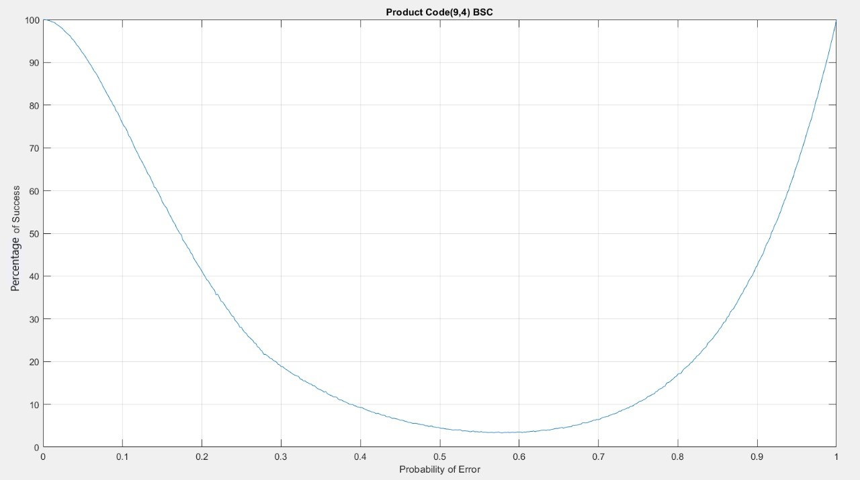

Slide 30
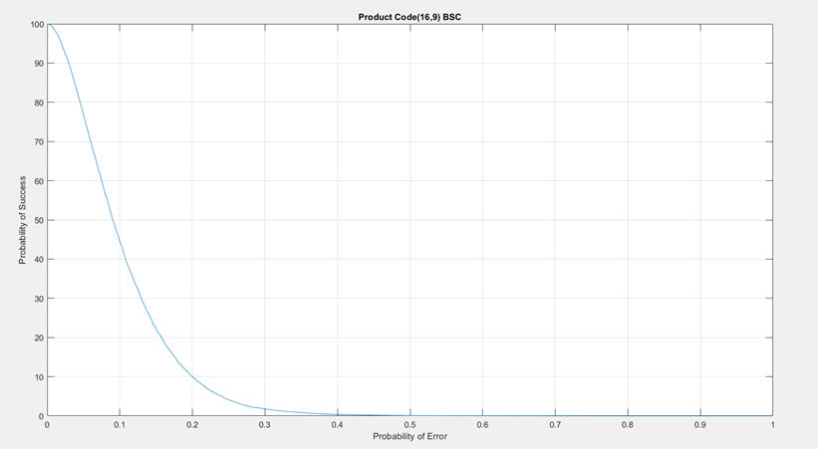
Percentage of Success

Slide 31
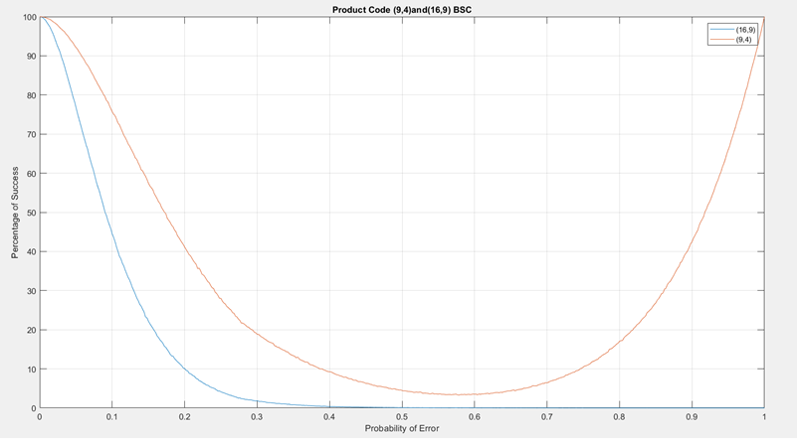

Slide 32
Reason Behind BSC Conundrum
When k is even:
The maximum of XOR of all values in row and column other than the value to be checked always gives the correct value
This means when p=1, success probability is 1.
When k is odd:
The maximum of XOR of all values in row and column other than the value to be checked always gives the wrong value
This means when p=1, success probability is 0.

Slide 33
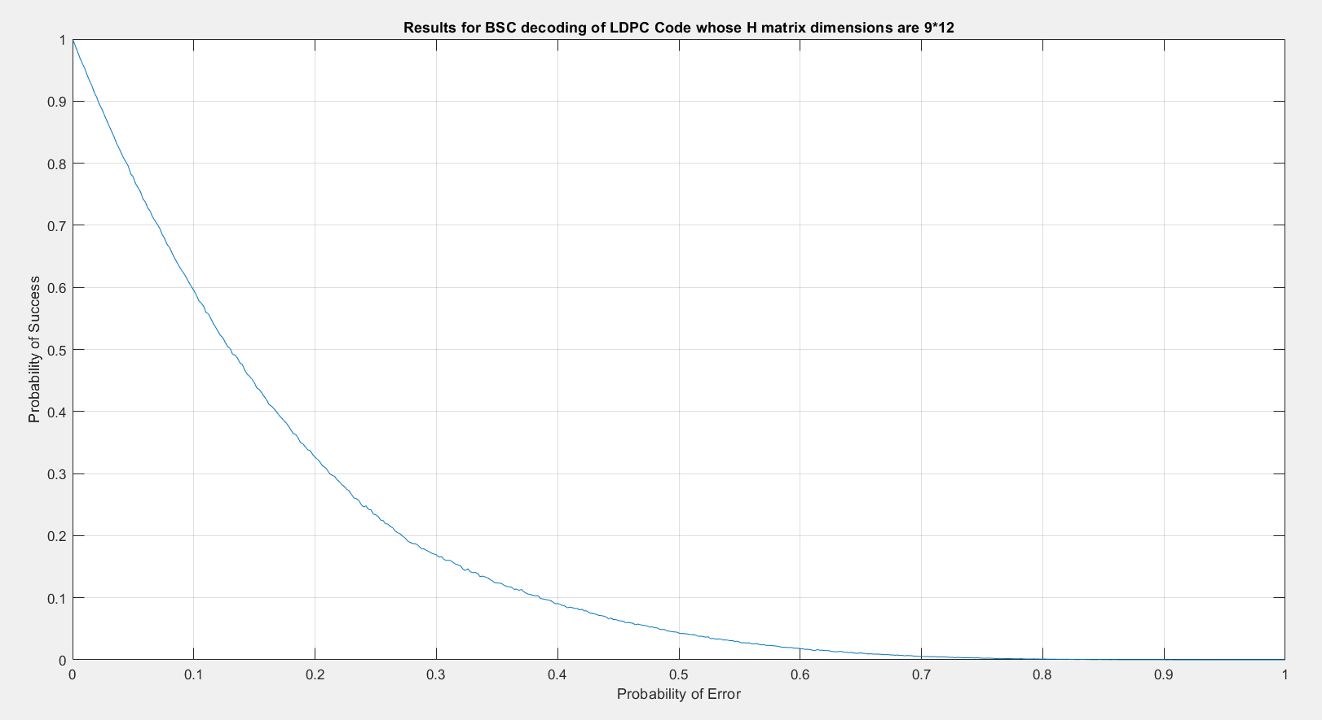

Slide 34
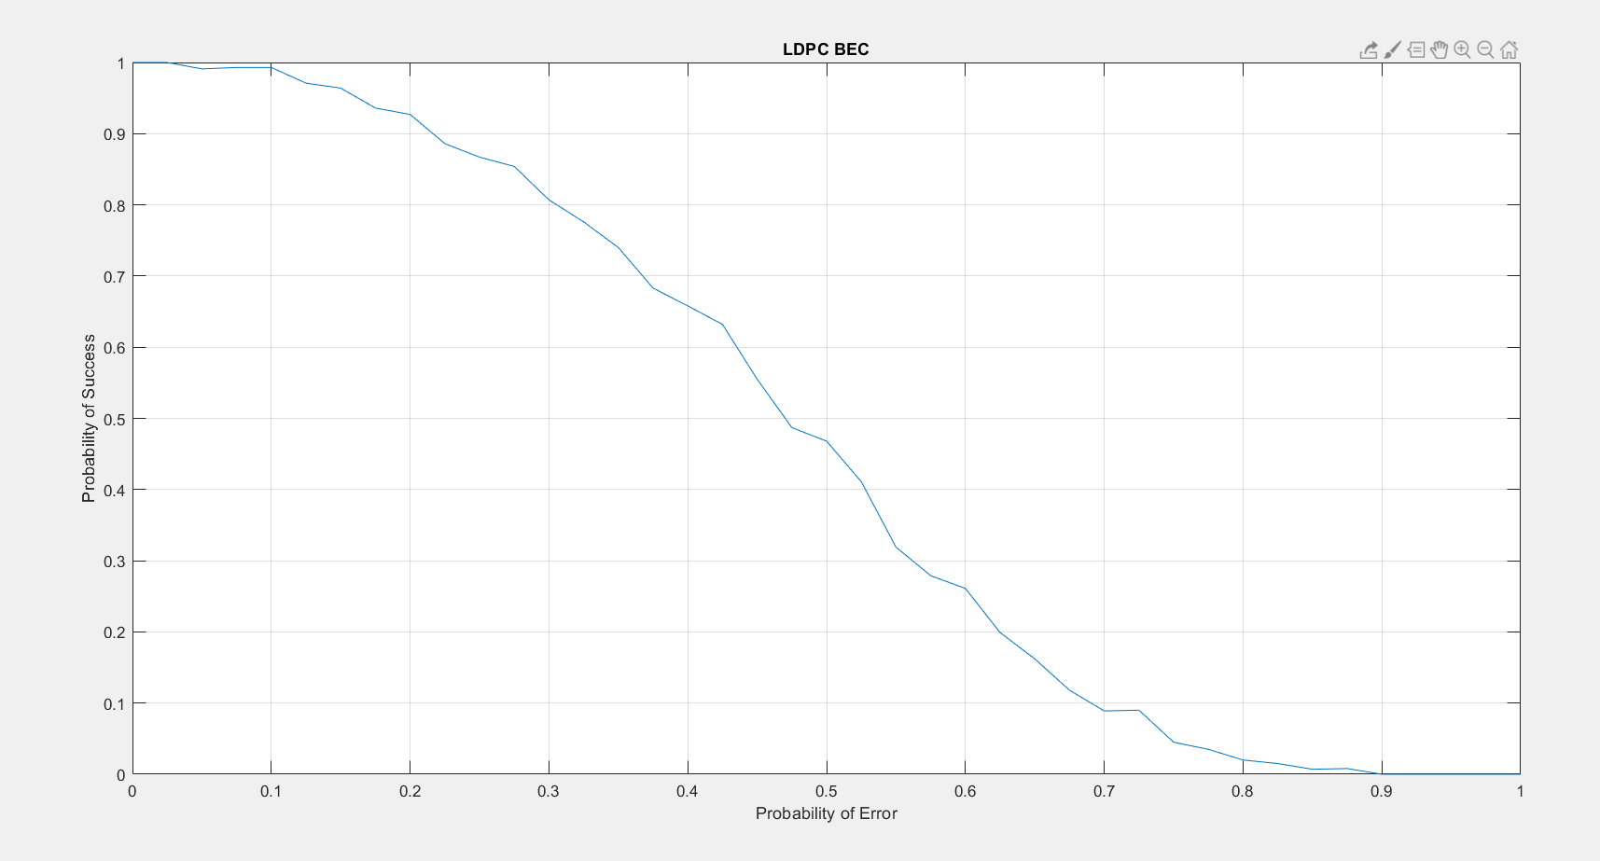

Slide 35
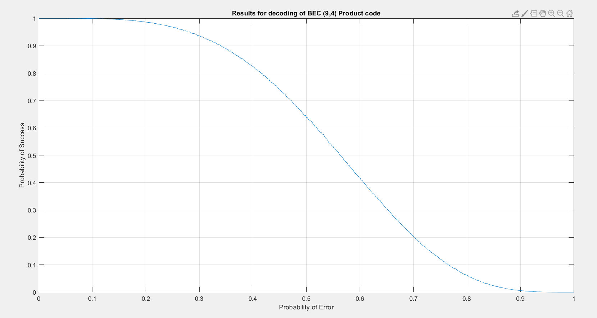

Slide 36
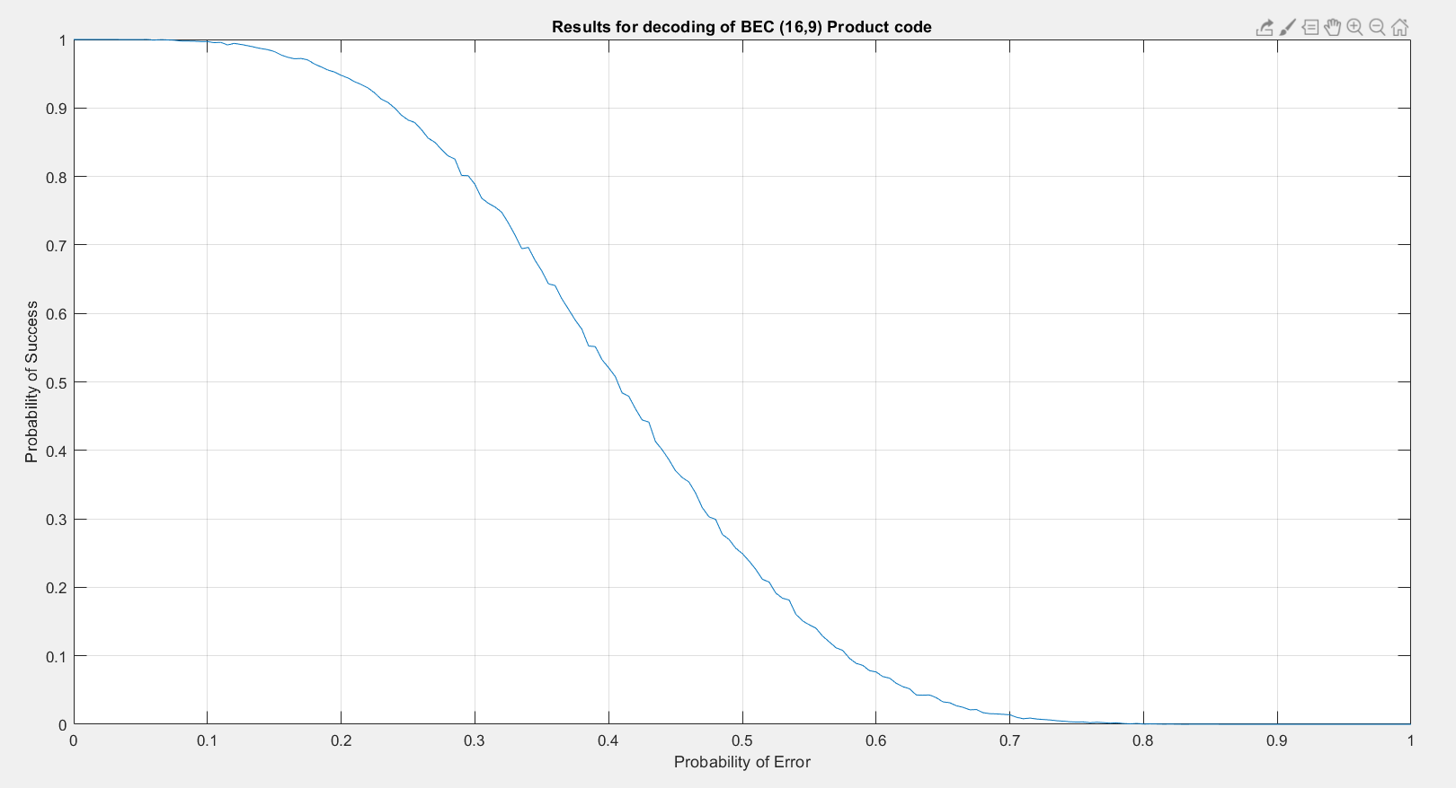

Slide 37
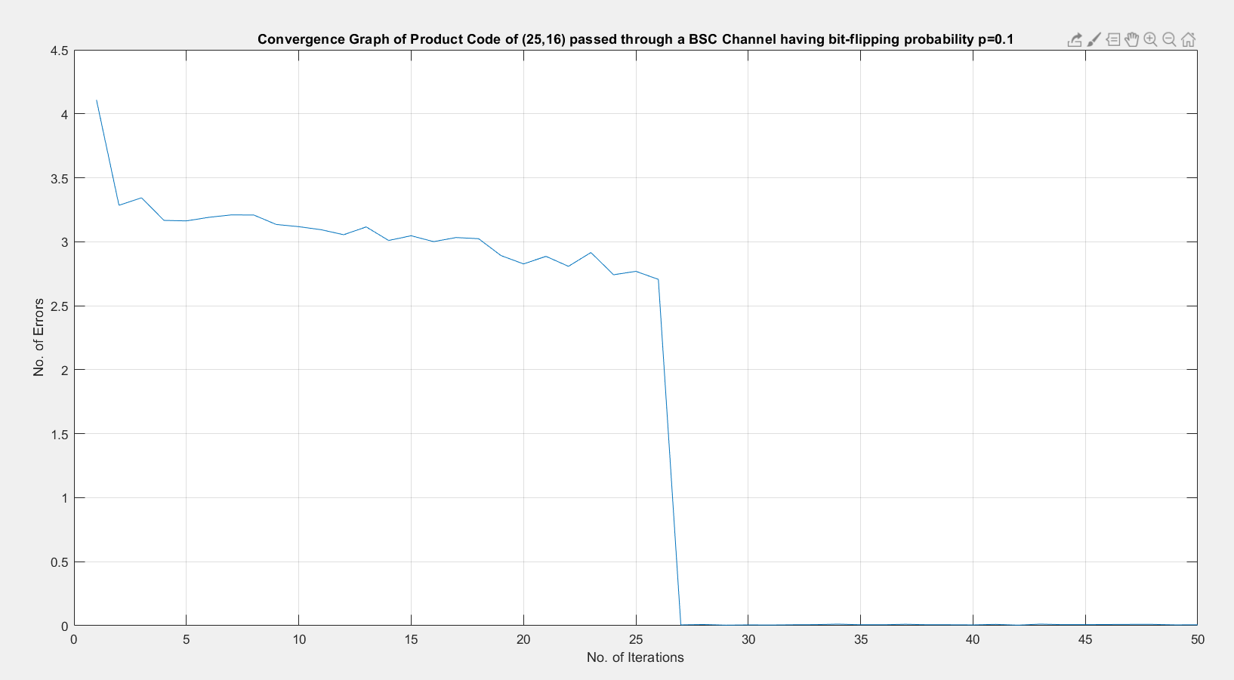

Slide 38
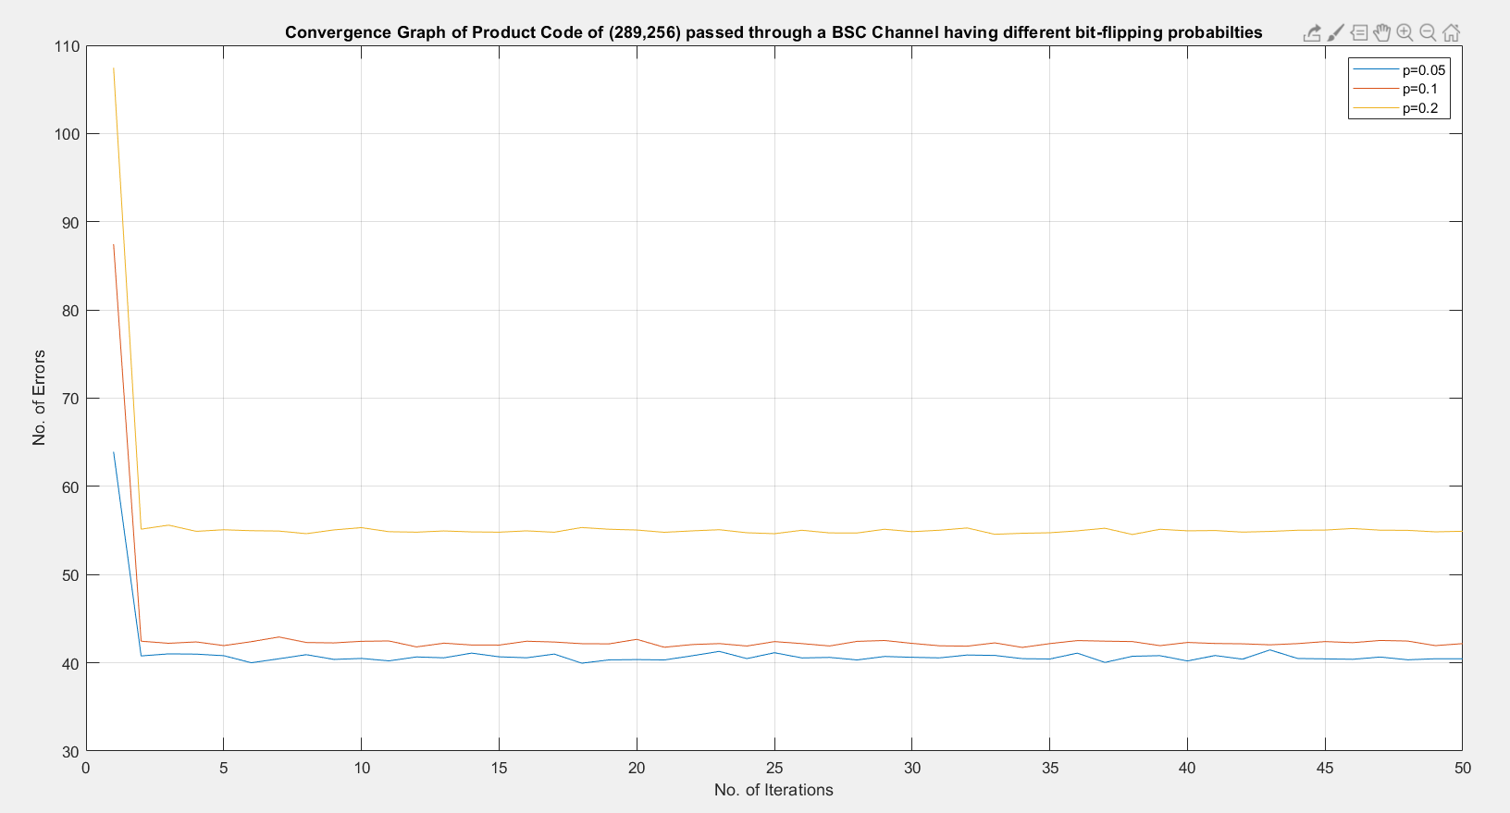

Slide 39
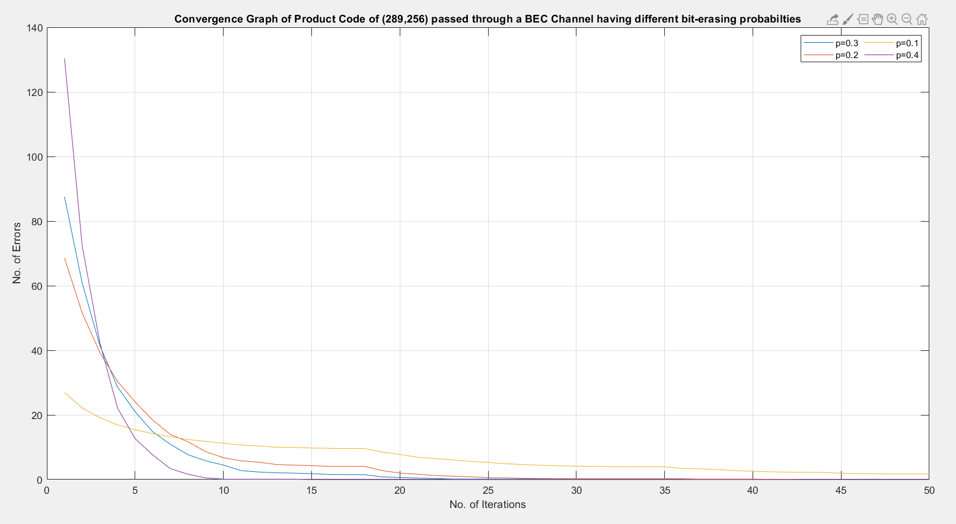

Slide 40
Theoretical analysis for successful decoding of Product code
For a product code of (n,k)
Tc=2*sqrt(k) +1
For i between 1 to Tc
if(i<4)
Logic1
Else
Logic2
Here, i = number of bits flipped.

Slide 41

Logic1

Slide 42

Logic2

Slide 43

Just an example

Slide 44
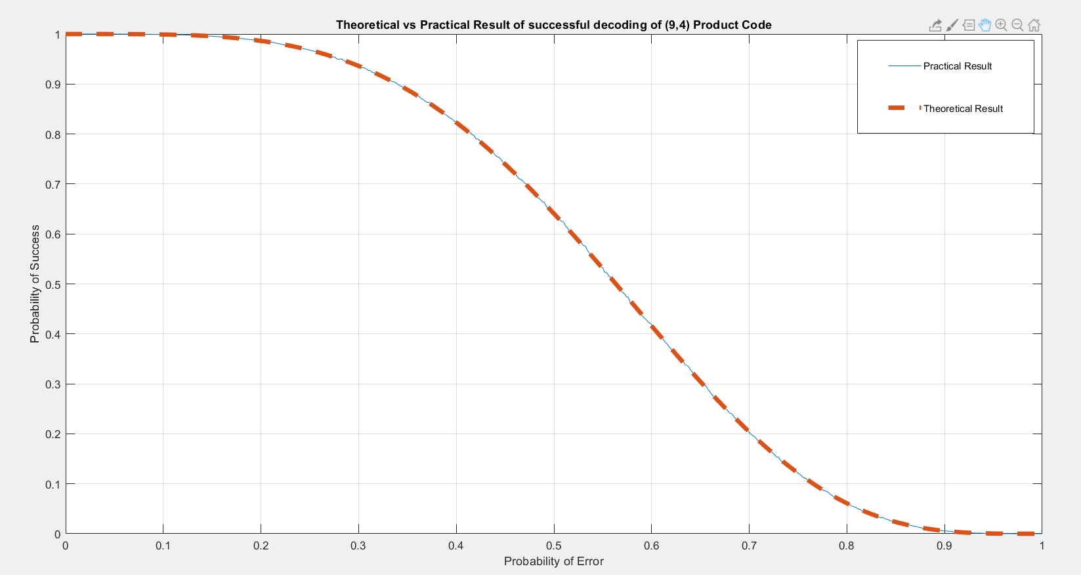

Slide 45
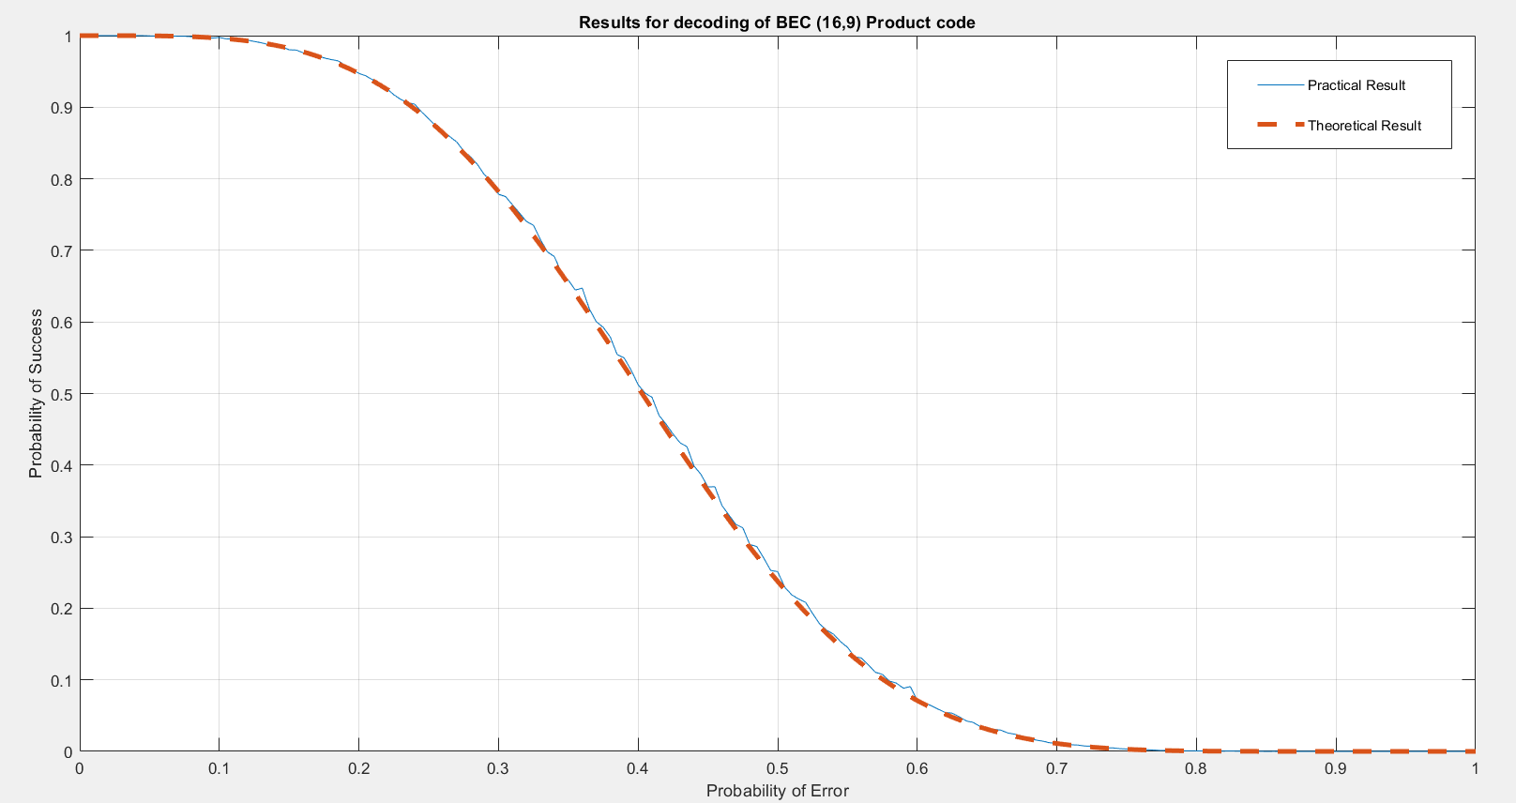

Slide 46
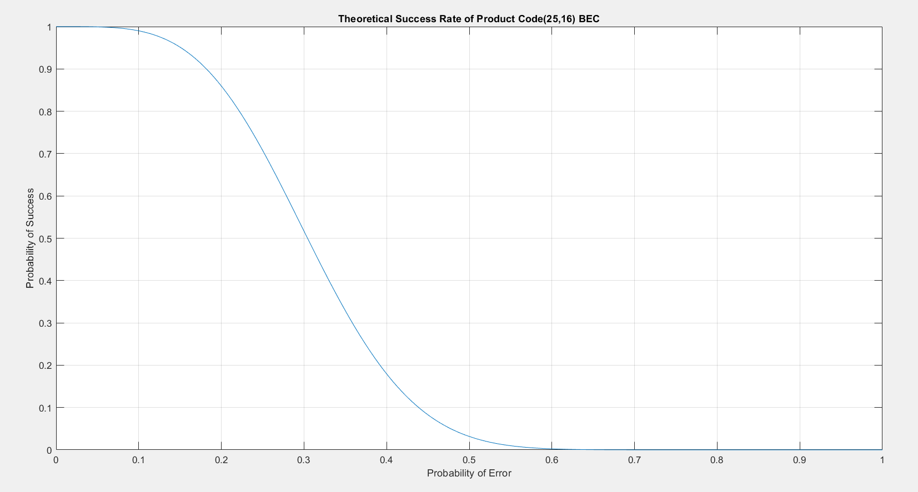

Slide 47
Summary/Conclusion
We came to know, the working of BEC, BSC channels and decoding product code and LDPC code through Tanner graph.
Error correcting for BEC showed higher success rate as compared to BSC channel, because in BSC channel there are cases of unexpected flips of the already correct code, whereas in BEC, we are only retrieving the missing bits.
LDPC showed higher accuracy as compared to product code because in LDPC, there are more check nodes present, hence more connections of a variable node to different check nodes.
Product code is limited only to perfect square values of k, whereas LDPC code is not limited.

Slide 48
We are grateful...
It was a very informative and enjoyable experience for all of us. We learnt how to work as a team(a team with no leaders). Through coding perspective too, we learnt and applied many new things which we had never tried before, for example, file handling. In total, this project made us expand our boundaries and given us a lot of information and boosted our self-confidence that we can learn on our own. We would like to thank prof. Yash Vasavada and our TA, Naimishi Gupta for all the help and being there for us when we needed. We look forward to more exciting projects like this in our college life.

Slide 49
THANK
YOU

